Slide 1
Analysis of Religious Trends
Ali Taheri

Slide 2
Agenda
Introduction
Statement
Global Analysis
Regional Analysis
National Analysis
Conclusion

Slide 3
Introduction

Slide 4
What does religion mean to you?
Something one believes in and follows devotedly
A believe to existence of a higher power, spirits or God
An explanation of the origins and purpose of humans and their role on earth
It is supposed to enlighten our lives
It could promote peace but sometimes causes conflicts!

Slide 5
Main Religions
Abrahamian ones:
Christianity
Catholicism
Protestantism
Eastern Orthodoxy
Islam
Sunni
Shia
Judaism
Ethnic ones:
Buddhism
Hinduism
Syncretism
Shintoism
Confucianism
Daoism
Animistic Religions

Slide 6
Statement

Slide 7
Despite the unprecedented progress and unparalleled discoveries in science and technology, today most people still hold a strong faith in religion.

Slide 8
Global Analysis

Slide 9
Word Cloud of Religions

Slide 10
Global Population
Christianity is the most popular religion
Population of all religions are increasing
People without religion are increasing too!
Is it because of increase in world population?

Slide 11
Global Percentages
Islam is the most growing religion
Christianity is the most steady one
Adherence to Syncretism is more than Buddhism
Hinduism > Buddhism
Tendency to religions is not declining
What about branches!?

Slide 12
Branches of Christianity and Islam
Catholicism wins!
Sunni wins but Shia is growing more!

Slide 13
Regional Analysis

Slide 14
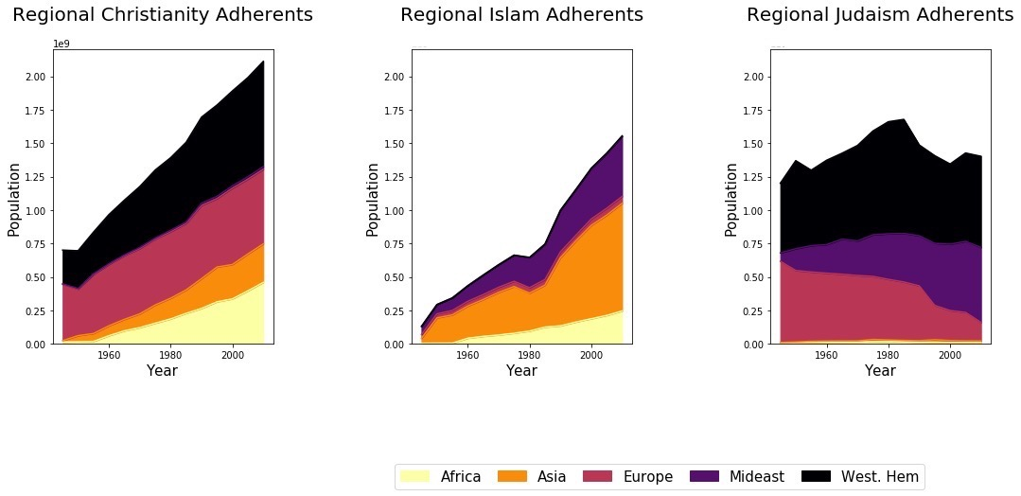
Regional Abrahamian Populations
Christianity
Is rare in Middle East
Big increase in Africa and Asia
Stable in Europe!
Islam
Is rare in western countries
Tremendous increase in Africa, Asia and Middle East
Judaism
Declining in Europe after WW II
Growing in ME and West Hemisphere due to Israel

Slide 15
Regional Abrahamian Percentages
Christianity
Stable in West Hemisphere
Big decline in Europe
Islam
Fixed in Asia and Middle East
Big jump in Africa
Slight decline in Europe

Slide 16
Ethnic Religions Populations
Mainly in Asia
Minority of them in West Hemisphere
Big jump of Hinduism

Slide 17
Ethnic Religions Percentages (Outside Asia)
Tendency of Africans to Hinduism
Tendency of Europeans to Buddhism
Great adherence of West Hemisphere to Syncretism

Slide 18
National Analysis

Slide 28
Conclusion

Slide 29
Forecasts of PEW research for 2050:
Number of Muslims ≃ Number of Christians
Atheists and Agnostics are increasing in USA and France but their share of the world’s total population will decline.
Buddhist population is steady, while Hindu and Jewish populations will grow.
10% of European would be Muslim.
India will retain a Hindu majority but also will have the largest Muslim population, surpassing Indonesia.
In USA, Christians will decline from 3/4 in 2010 to 2/3 in 2050, and Muslims would be more than Jewish on the basis of religion.

Slide 30
Please ask me your last question!

